Slide 1
Recurrent Networks & LSTMs
Connor Schenck

Slide 2
Definition
What is a recurrent neural network?

Slide 3
Definition
What is a recurrent neural network?
A recurrent neural network is a network that is recurrent!
:)

Slide 4
Definition
What is a recurrent neural network?
A network designed to be called multiple times in sequence, i.e., not a DAG.

Slide 5
Definition
What is a recurrent neural network?
Normal NN (DAG):
Input
Magic
Output

Slide 6
Definition
What is a recurrent neural network?
Normal NN (DAG):
Recurrent NN (not a DAG):
Input
Magic
Output
Input
Magic
Output
Recurrence

Slide 7
Types of RNNs
Timeseries
Data recurrent networks
  E.g. Equilibrium nets: https://arxiv.org/abs/1602.05179

Slide 8
Types of RNNs
Timeseries
Data recurrent networks
  E.g. Equilibrium nets: https://arxiv.org/abs/1602.05179

Slide 9


Find Bilbo

Slide 10
Find Bilbo
Standard NN
?
?

Slide 11
Find Bilbo
Recurrent NN
Memory
Memory
t=1
t=2
t=3
t=4

Slide 12
RNN
Bilbo Detector
t=1

Slide 13
RNN
Bilbo Detector
Bilbo Detector
t=1
t=2

Slide 14
RNN
Bilbo Detector
Bilbo Detector
Bilbo Detector
Bilbo Detector
t=1
t=2
t=3
t=4

Slide 15
RNN
dwdy
dwdy
dwdy
dwdy
Bilbo Detector
Bilbo Detector
Bilbo Detector
Bilbo Detector
dwdy
dwdy
dwdy
dwdy
t=1
t=2
t=3
t=4

Slide 16
RNN
dwdy
dwdy
dwdy
dwdy
dwdy
dwdy
dwdy
Bilbo Detector
Bilbo Detector
Bilbo Detector
Bilbo Detector
dwdy
dwdy
dwdy
dwdy
t=1
t=2
t=3
t=4

Slide 17
RNN
dwdy
dwdy
dwdy
dwdy
dw
dy
dw
dy
dwdy
Bilbo Detector
Bilbo Detector
Bilbo Detector
Bilbo Detector
dwdy
dwdy
dwdy
dwdy
t=1
t=2
t=3
t=4

Slide 18
Long Short-Term Memory Units (LSTMs)
A specially designed network layer that prevents exploding/vanishing gradients

Slide 19
Long Short-Term Memory Units (LSTMs)
Conv
Conv
Conv
Conv
Conv
Fully-Connected
Fully-Connected

Slide 20
Long Short-Term Memory Units (LSTMs)
Conv
Conv
Conv
Conv
LSTM
Fully-Connected
Fully-Connected

Slide 21
Long Short-Term Memory Units (LSTMs)
Conv
Conv
Conv
Conv
Conv
Conv
Conv
Conv
Conv
Conv
Conv
Conv
LSTM
Cell State
LSTM
Cell State
LSTM
Fully-Connected
Fully-Connected
Fully-Connected
Fully-Connected
Fully-Connected
Fully-Connected
t-1
t
t+1

Slide 22



Inside a (basic) LSTM
Input
Forget Gate
Input Gate
Block Input
Output Gate
Cell State
Cell State
Output

Slide 23
Inside a (basic) LSTM
Input
Forget Gate
Input Gate
Block Input
Output Gate
Cell State
Cell State
What to remember?
What to forget?
What to output?
Output

Slide 24

Inside an LSTM
Input
Recurrent State
Forget Gate
Input Gate
Block Input
Output Gate
Cell State
Cell State
Output
Recurrent State

Slide 25
Inside an LSTM
Input
Recurrent State
Forget Gate
Input Gate
Block Input
Output Gate
Cell State
Cell State
Output
Recurrent State

Slide 26
Gated Recurrent Unit (GRU)
Input
Recurrent State
Update Gate
Reset Gate
Block Input
1-
Recurrent State
Output

Slide 27
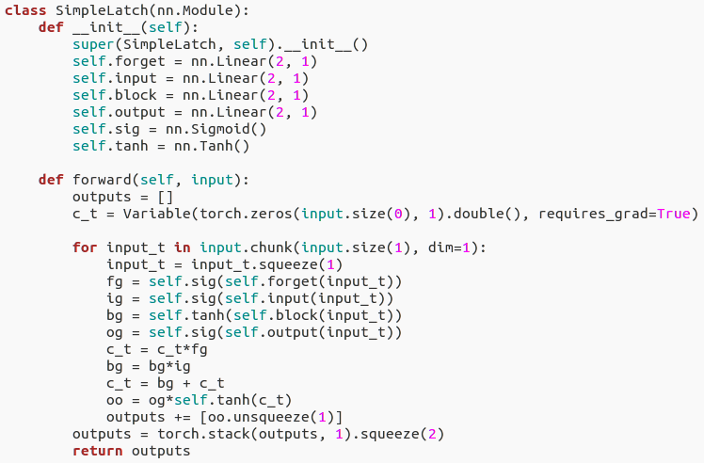
Code (PyTorch)

Slide 28
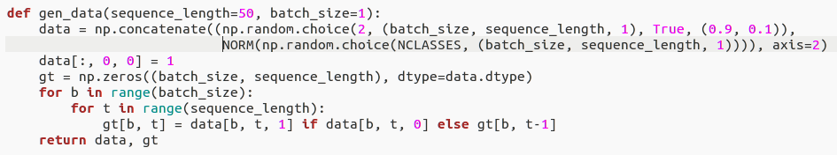
Code (PyTorch)
1 0 0 0 1 0 1 0 0 0 0 0 0 0 1 0 0 0 1
2 6 1 8 4 0 3 6 8 2 5 3 1 6 2 7 4 8 5
2 2 2 2 4 4 3 3 3 3 3 3 3 3 2 2 2 2 5
Input:
Target:

Slide 29
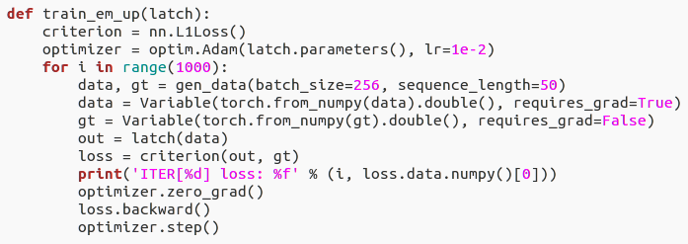
Code (PyTorch)

Slide 30
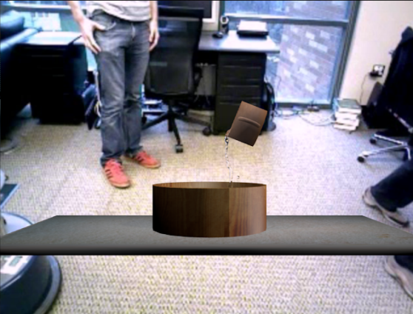

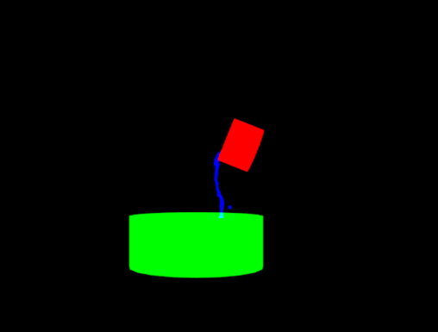

LSTM Example -
Detecting & Tracking Water

Slide 31
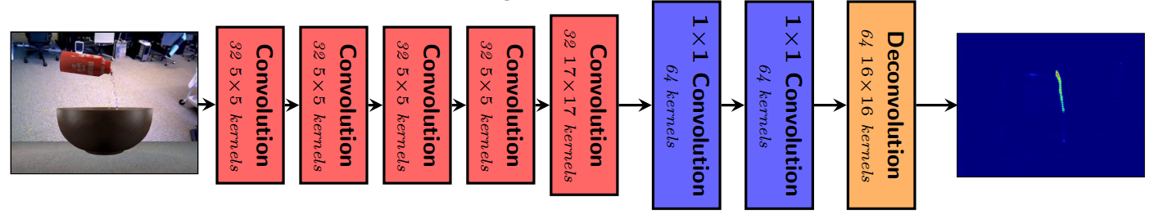
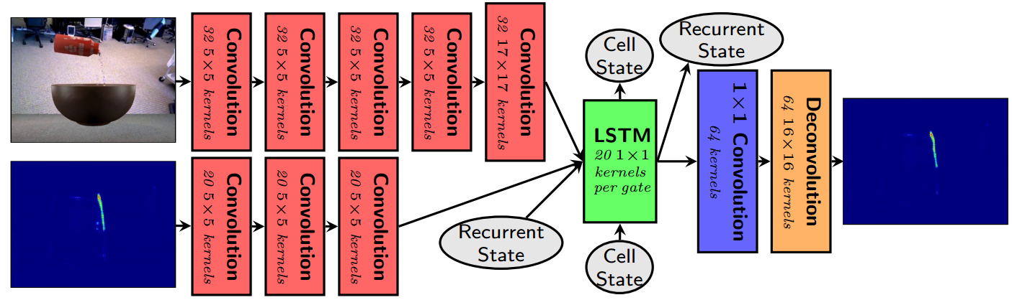
LSTM Example -
Detecting & Tracking Water

Slide 32
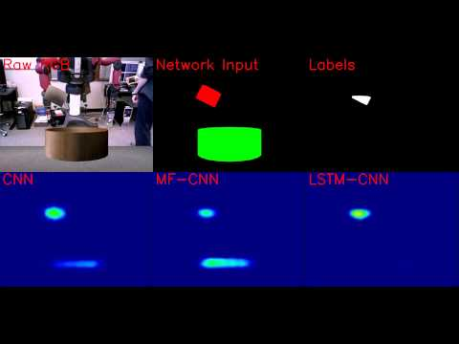

Slide 33
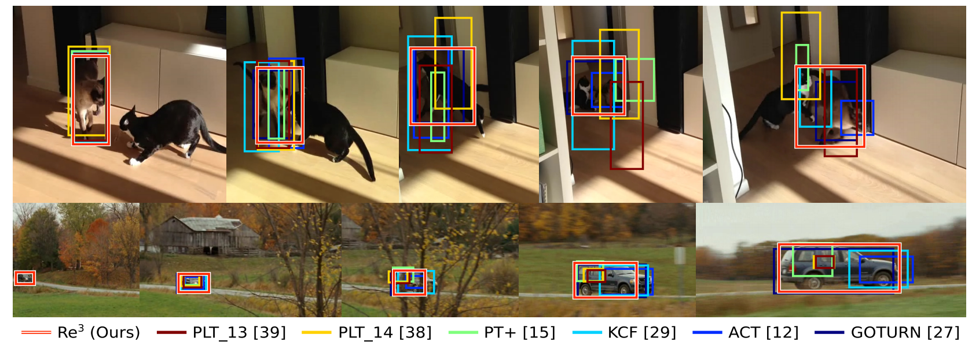
RE3 - Tracking Arbitrary Objects

Slide 34
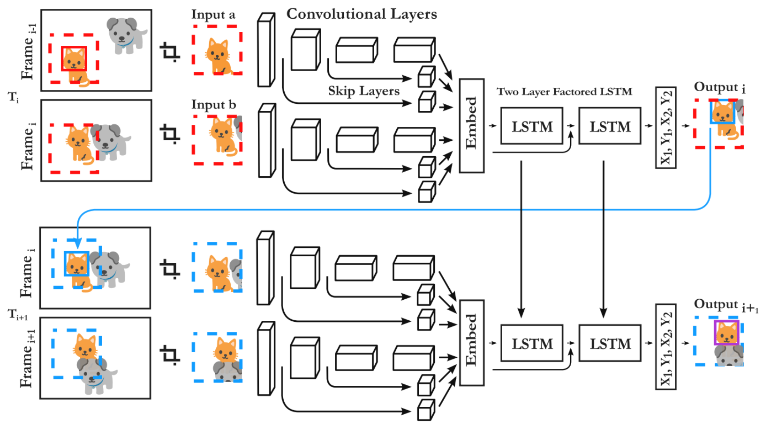
RE3 - Tracking Arbitrary Objects

Slide 35
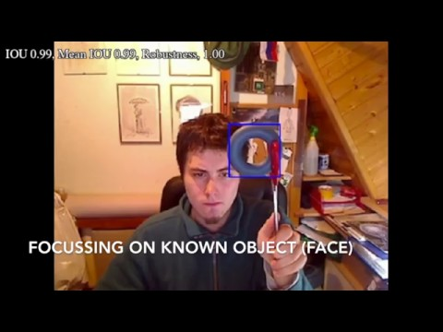
RE3 - Tracking Arbitrary Objects

Slide 36
Links
Papers
  LSTM: A Search Space Odyssey
  Learning Phrase Representations using RNN Encoder–Decoder for Statistical Machine Translation (GRU)
  Re3: Real-Time Recurrent Regression Networks for Object Tracking
  Perceiving and Reasoning About Liquids Using Fully Convolutional Neural Networks
Explanations
  WildML - GRU/LSTM RNNs
  Colah’s Blog - Undestanding LSTM Networks

Slide 37
RE3 - Tracking Arbitrary Objects
DEMO!!!

